Slide 1
5110 Big Data
Team 1 – Step Function
(Daniel Anthony, Harold Haugen, zachary Lisman, George Shoriz

Slide 2
Step Function Execution
What are Step Functions: Broadly, AWS defines the Step Function process as:
“ With AWS Step Functions, you can create workflows, called State machines, to build distributed applications, automate processes, orchestrate microservices, and create data and machine learning pipelines.
Step Functions is based on state machines and tasks, with State machines being called workflows, which are a series of event-driven steps. Instances of running workflows performing tasks are called executions in Step Functions.
Depending on a use case, you can have Step Functions call AWS services, such as Lambda, to perform tasks. You can also have Step Functions control AWS services, such as AWS Glue, to create extract, transform, and load workflows and create long-running, automated workflows for applications that require human interaction. “
https://docs.aws.amazon.com/step-functions/latest/dg/welcome.html

Slide 3
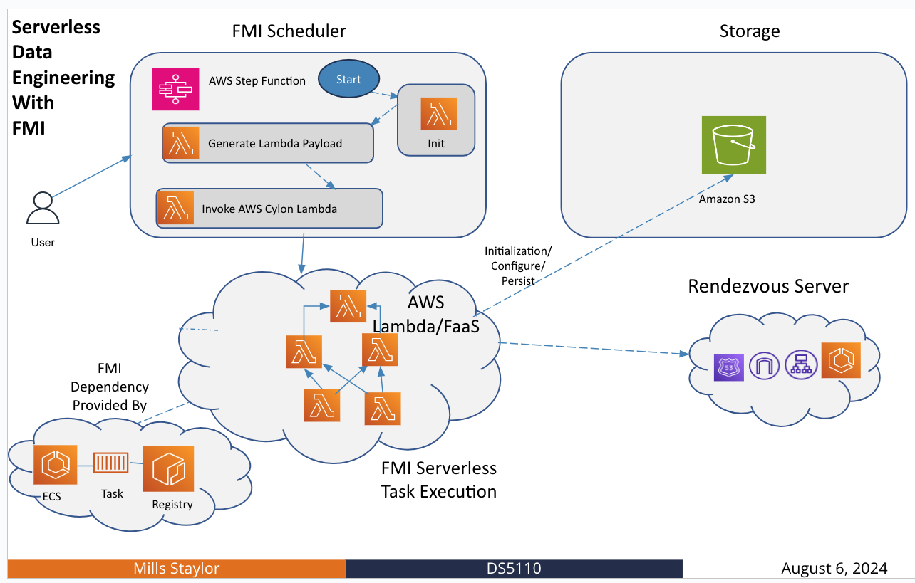
Step Function Execution
The AWS Step Function allows our team to push up Payload Python scripts into AWS Lambda/FaaS for execution.

Slide 4
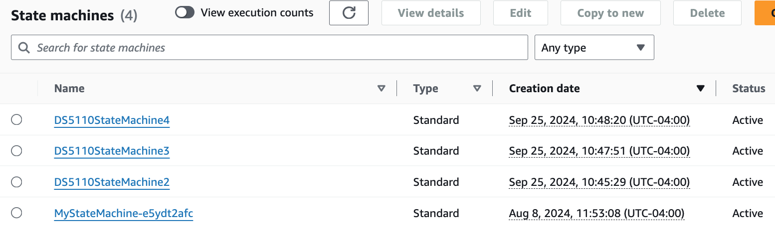
Step Function Execution
State Machine Execution
Our Team (Team 1) created three State Machine ‘executions’ as a trial to confirm that:
a) we could create a Workflow in AWS, b) load in a sample Python script to completion, and c) observe how modifications to the ‘World_Size’ parameter would affect execution time and cost; which will be taken under consideration in future workflow design.
We used the ‘MyStateMachine-e5ydt2afc’ as our primary State machine to build each execution.

Slide 5
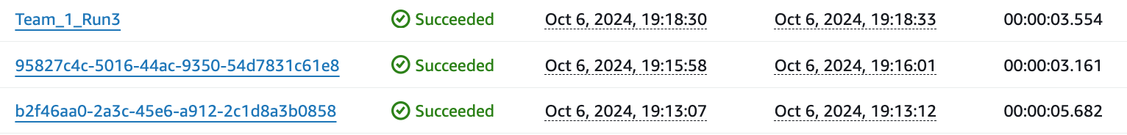
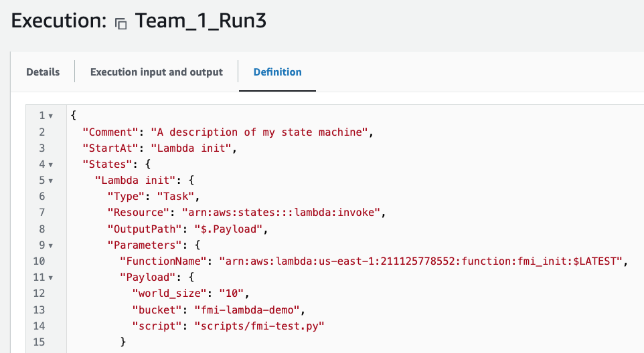
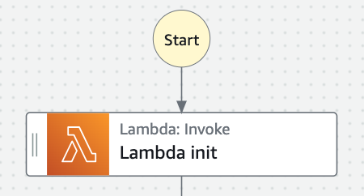
Step Function Execution
For each execution, we entered the Lambda Init phase of the workflow and edited the world World_Size parameter.
Three Executions performed:
For each execution, we updated ‘world_size’ to values of 2, 10 and 24.
Note, for the ‘Team_1_Run3’ execution, world_size was set to 10.
Also, ‘bucket’ was kept to fmi-lambda-demo’.
Notes:
World size is the number of processes used your training, which is usually the number of GPUs you are using for distributed training.
Rank is a unique ID given to a process, so that other processes know how to identify a particular process. (Stack Overflow)

Slide 6
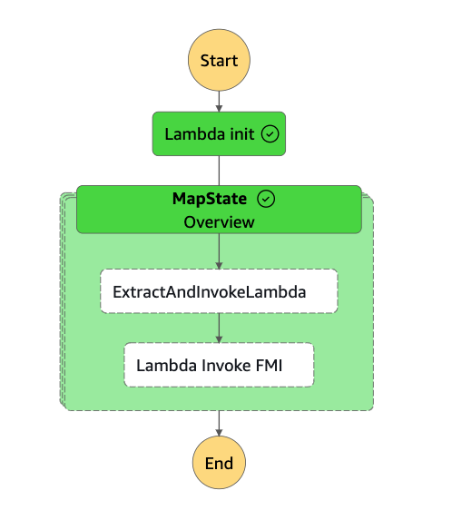
Step Function Execution
Performance Monitoring
Upon monitoring for successful completion (see workflow graph), we reviewed execution metrics captured in the CloudWatch Logs, under the FMI_Executor log group (via Python filters). The following table outlines results for Rank 0 and 1 nodes.
 | Exec. | 'world_size’ | Rank | Request ID | Duration | Billed Duration | Memory Size | Memory Used
1 | c61e8 | 2 | 0 | REPORT RequestId: xxx-6f3a9ce712f0 | Duration: 300.54 ms | Billed Duration: 301 ms | Memory Size: 10240 MB | Max Memory Used: 145 MB
2 | c61e8 | 2 | 1 | REPORT RequestId: xxx - 6578018f4698 | Duration: 255.44 ms | Billed Duration: 256 ms | Memory Size: 10240 MB | Max Memory Used: 144 MB
3 | Team_1 _Run3 | 10 | 0 | REPORT RequestId: xxx-2406456e42b3 | Duration: 366.88 ms | Billed Duration: 367 ms | Memory Size: 10240 MB | Memory Used: 145 MB
4 | Team_1 _Run3 | 10 | 1 | REPORT RequestId: xxx-f0bc2a87cc74 | Duration: 349.07 ms | Billed Duration: 350 ms | Memory Size: 10240 MB | Memory Used: 145 MB
5 | b0858 | 24 | 0 | REPORT RequestId: xxx-ae02f0011f59\t | Duration: 1045.40 ms Init Duration: 744.94 ms | Billed Duration: 1791 ms | Memory Size: 10240 MB | Max Memory Used: 143 MB
6 | b0858 | 24 | 1 | REPORT RequestId: xxx-180f45b70770\t | Duration: 1060.50 ms Init Duration: 710.79 ms | Billed Duration: 1772 ms | Memory Size: 10240 MB | Max Memory Used: 143 MB
Monitored each workflow for Successful Completion (with all Green)

Slide 7
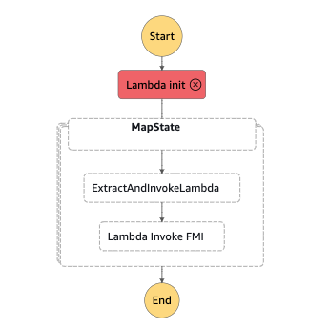
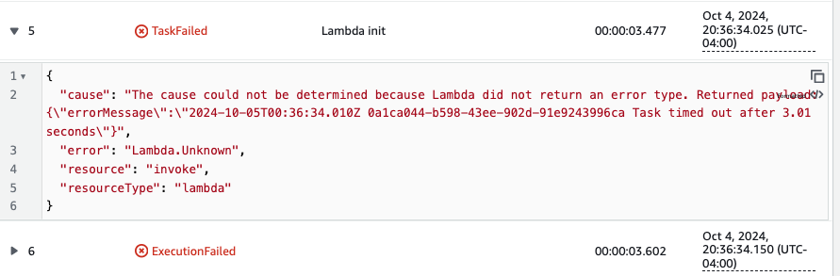
Step Function Execution
Failure Points
During our initial run of the Step Function, we did witness a Failure.
This was apparently caused due to the The Rendezvous server needing to be restarted. A periodic restart should be executed to prevent his issue each week.
Observed Failure

